Slide 1

Predicting Risk Of Smoking, Alcohol And Drug Use Among Adolescents
Syam Krishna Sujith Kolapalli
Msc DataScience
University of Hertfordshire

Slide 2

Research Question
What factors influence risky behaviours among adolescents in England
How demographic, school, and socioeconomic indicators affect behavioural risks
How machine learning models can predict high-risk adolescents
How insights from predictions can support early public health interventions

Slide 3

What Previous Studies Have Found…??
Adolescent substance use influenced by social, family, school, and neighborhood factors
Previous research highlights strong links with deprivation, peer behavior, and school engagement
Machine learning used in public health for early risk detection and prevention
Project builds on earlier studies by combining multiple national datasets and advanced models

Slide 4

Dataset Description
Four official Datasets were used:
Pupil dataset: 14,226 rows × 657 features
Teacher dataset: 89 rows × 64 features
IMD dataset: 32,844 rows × 57 features
Local Authority Districts (LAD) to Regions
All data taken from NHS and UK government open data portals.
All sources are public and ethically safe for research
Datasets were combined to make Multi-dimensional Behavioural risk Dataset

Slide 5

Data Pre-Processing
Handling Missing Values
Remove Outlier
Encoding & Merging
Categorical features were label-encoded, where numerical features are scaled where needed and Clean datasets were merged using common keys forms the foundation for training accurate and generalizable models.
Preprocessing includes handling missing values, data cleaning, and converting data types where needed.
Outliers may be treated or removed to improve model stability.

Slide 6

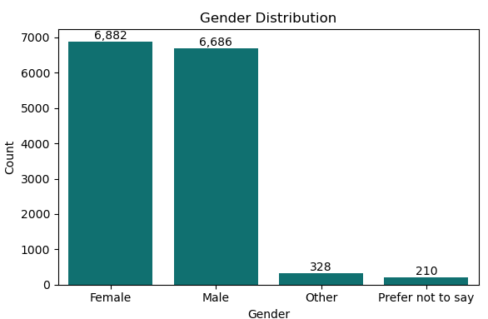
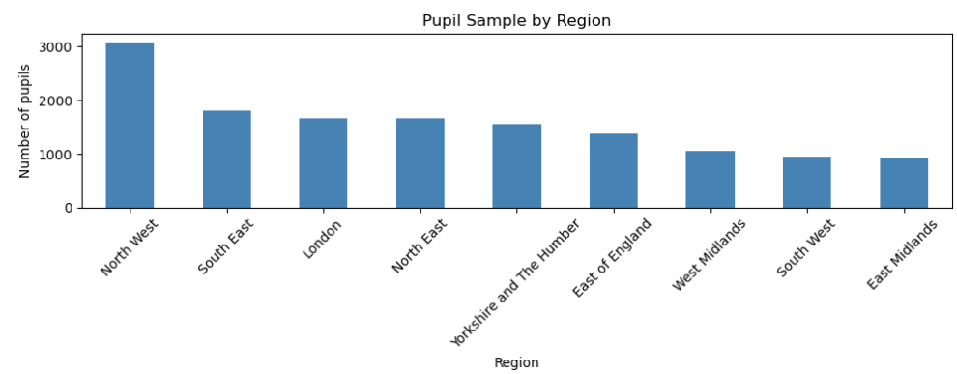
EDA ( Data Overview & Distributions)
Gender Distribution: The bar plot shows a near-even split, with Male (6,686) and Female (6,882) pupils representing the vast majority of the sample.
Regional Distribution: The bar plot indicates the North West has the largest pupil sample, while the West Midlands has the smallest in the data we had.

Slide 7

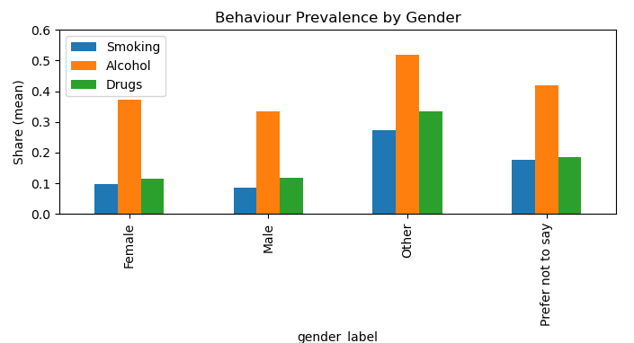
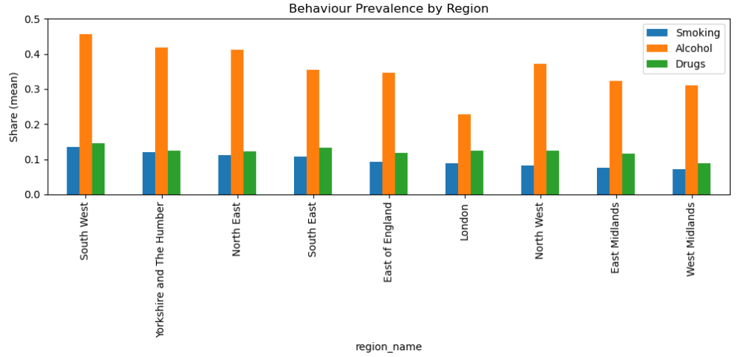
EDA (Relationships & Patterns)
Behaviour by Gender:For all gender groups, Alcohol shows the highest prevalence. The ‘other’ gender shows higher risk behavior because of very group and high psychological pressures reported in research.
Behaviour by Region: Alcohol is the most prevalent behavior across all regions. The highest overall prevalence for all behaviors is observed in the South West and North East regions as per the data.

Slide 8

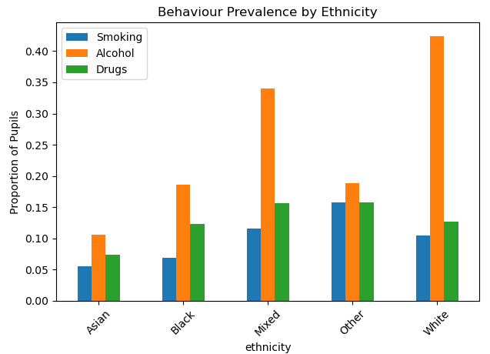
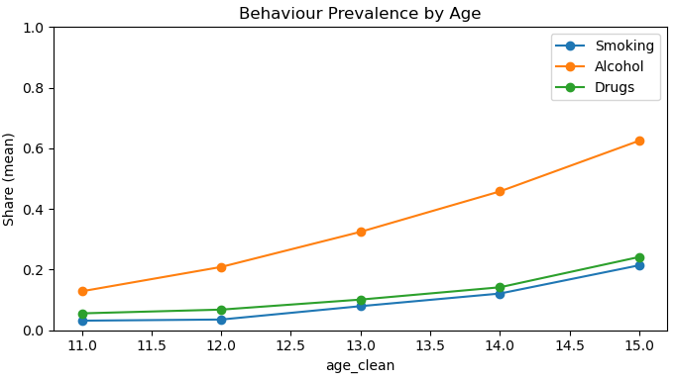
Prevalence by Ethnicity : It shows that White Ethnicity are more prevalent to alcohol and Asians are less when compared to other categories because white are largest proportion of pupil . Pupil from Mixed category stands second .
Prevalence by age : Age 15 is highly prevalent to Alcohol and other substances compared to younger ages. Study says that at this age
people Experience greater freedom and curiosity.

Slide 9



Model Building Steps
Model parameters are defined according to the chosen algorithm.
Tested Model on unseen data for validation.
Best Algorithm
Validation
Split Dataset
Train Model
Performance
Data is split into 75:25 training and testing subsets for fair evaluation.
The model is trained on the training data
Performance metrics help determine how well the model generalizes.

Slide 10

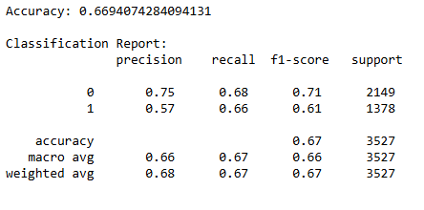
XGBoost Model and Results
XGBoost was chosen because it handles tabular data, captures complex patterns, manages imbalanced classes well, and provides strong performance and interpretability for predicting pupil risky behaviour.
The model achieves ~67% accuracy and detects 66% of risky-behaviour pupils, showing strong recall for the minority class. Overall, the model provides balanced and reliable performance for identifying at-risk students

Slide 11
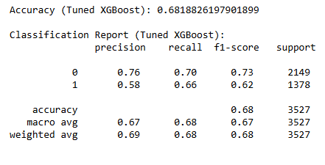
Hyperparameter Tuning &Result
Hyperparameter Tuning is used to optimise ML model’s performance by finding best combinations of settings. It improves accuracy, reduce overfitting, handle imbalanced data to make the model more stable and reliable.
The hyperparameter-tuned XGBoost model improved accuracy to 68%, boosted the recall of risky-behaviour pupils from 0.63 to 0.66, and increased the F1-score, making it more effective at identifying at-risk students compared to the baseline model.

Slide 12

Conclusion
The study used machine learning to predict substance use risk among adolescents in England.
The EDA identified that Alcohol is the most prevalent behavior across all regions and genders.
The Tuned XGBoost model achieved a useful 68% accuracy.
Model predictions were stronger for the majority class but weaker for the minority group.
Further work is needed to improve minority class performance to fully support early public health interventions.

Slide 13

References
Chen, T., & Guestrin, C. (2016). XGBoost: A scalable tree boosting system. Proceedings of the 22nd ACM SIGKDD Conference on Knowledge Discovery and Data Mining, 785–794.
Bergstra, J., & Bengio, Y. (2012). Random search for hyper-parameter optimization. Journal of Machine Learning Research, 13, 281–305.
NHS Digital (2023). Smoking, Drinking and Drug Use Among Young People in England: Survey Dataset.
NHS Digital (2023). SDD Teacher/School Dataset.
Ministry of Housing, Communities & Local Government (2019). English Indices of Deprivation 2019 (IMD).
Office for National Statistics (2020). Local Authority District to Region Lookup.

Slide 14

Thank you!

